Slide 1



UNIT 8: Fit and healthy
A heart of gold

Slide 2
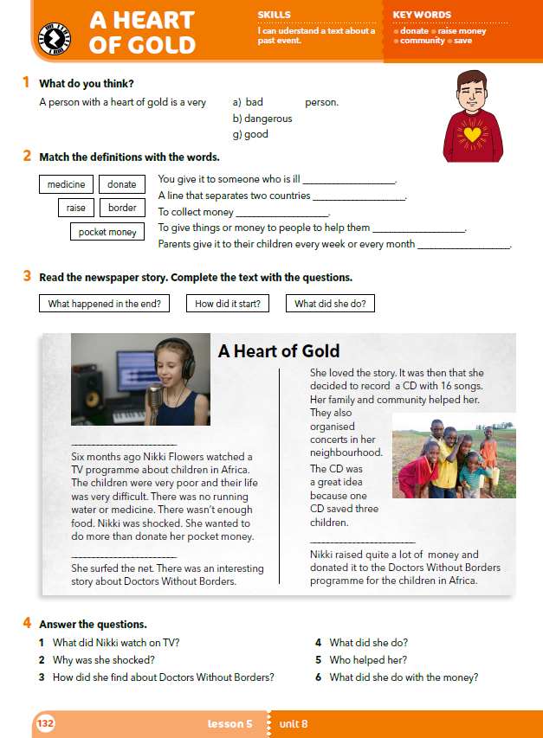
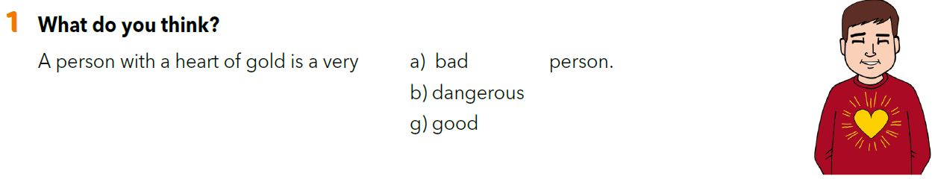
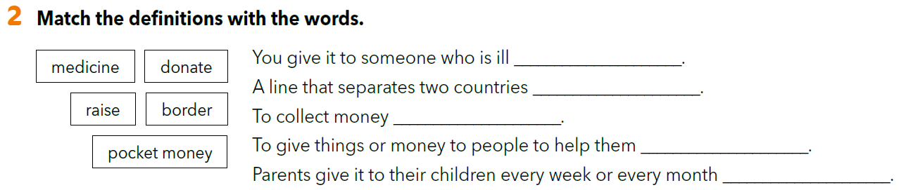
medicine
border
raise
donate
pocket money

Slide 3
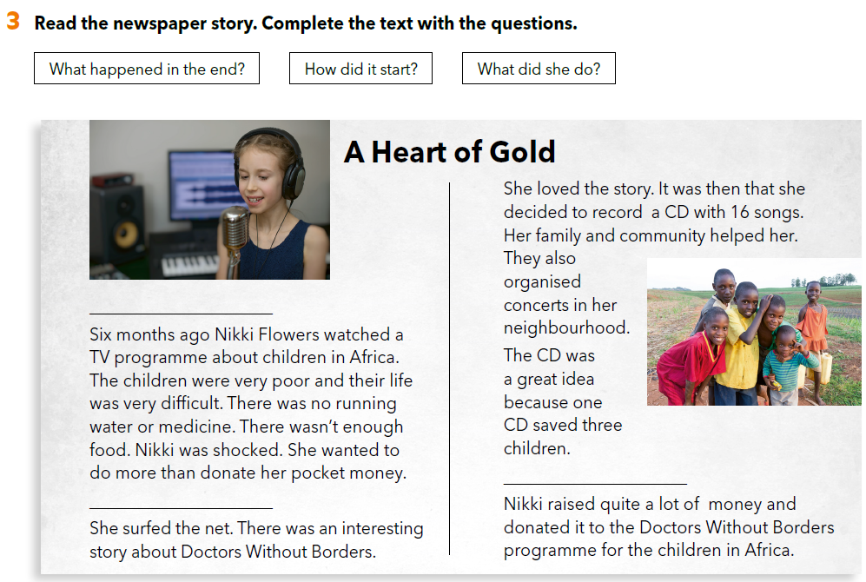

Slide 4
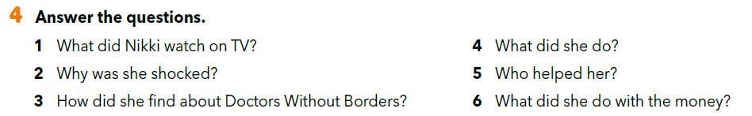
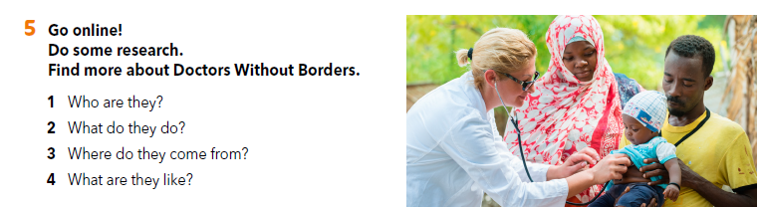

Slide 5
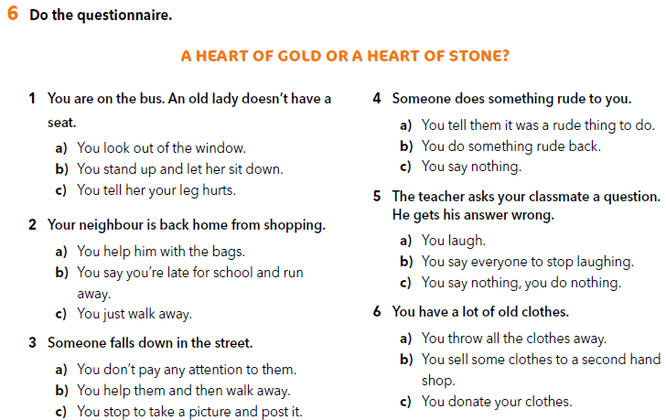

Slide 6
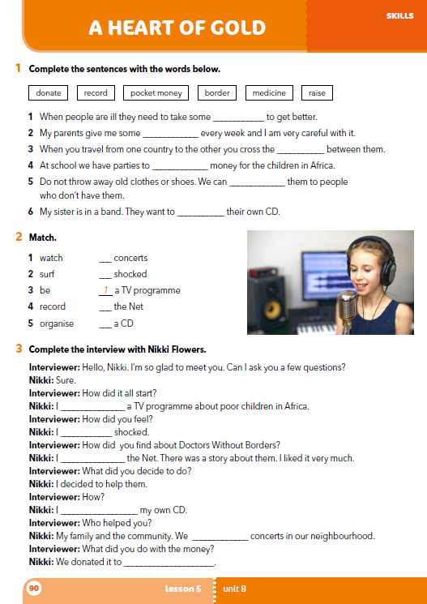
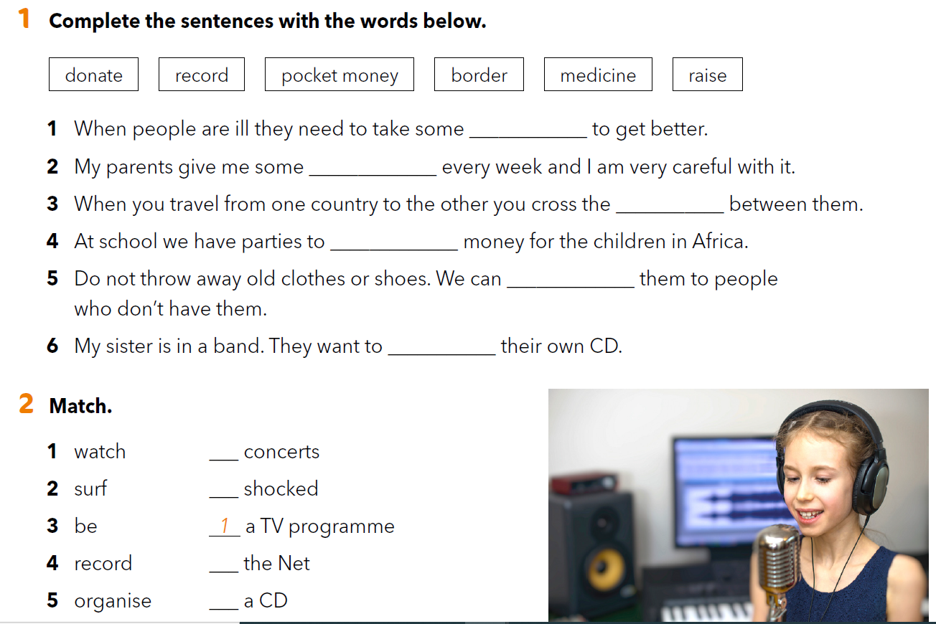
workbook p. 90
medicine
pocket money
border
raise
donate
record
5
3
2
4

Slide 7
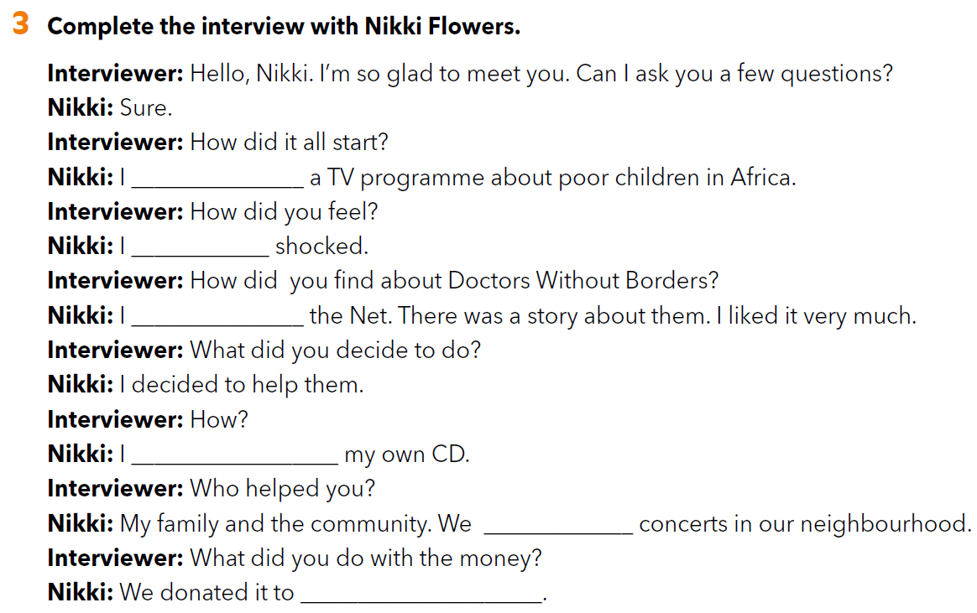
watched
was
surfed
recorded
organised
the Doctors Without Borders programme for the children in Africa.

Slide 8
LET’S REVISE!
https://wordwall.net/play/261/696/876

